Slide 1
ESA Activities and plans in spacecraft plasma interactions
A.Hilgers, D.Rodgers, F. Cipriani, K. Dannemayer
ESA/ESTEC, The Netherlands

Slide 2
Missions presently driving activities
Science missions
Under development
  Solar Orbiter (>0.28AU), Euclid (L2), Plato (L2) – M-class
  JUICE (Jupiter) and Athena (L1 or L2) – L-class
  CHEOPS (SSO), SMILE (Molniya) – S-class
M4 candidate science missions for 2025 launch
  THOR (HEO), XIPE (LEO), ARIEL (L2)
Notable others
  Galileo 2nd Generation (MEO)
  Proba-3 (GTO-like)
  Many Earth observation missions in SSO
  Metop SG
  Space Situational Awareness
  Electra (Electric orbit raising)

Slide 3
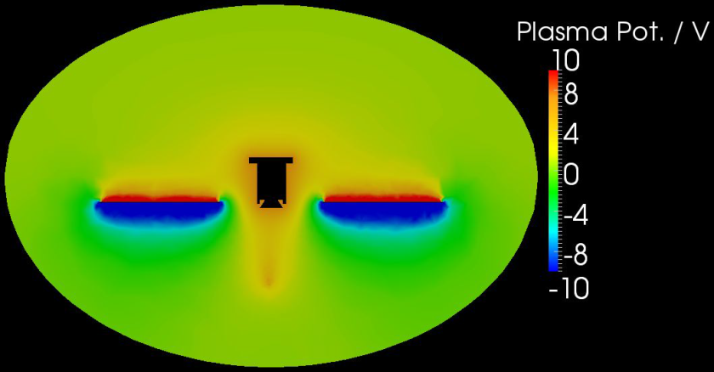
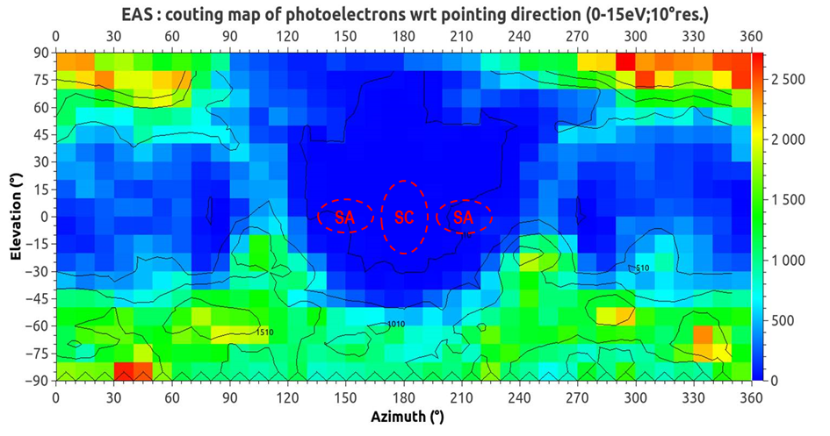
Performance of simulations
SPIS simulations
  Have become normal within European industry
  Also for ESA projects
  Also used by instrument teams

Slide 4
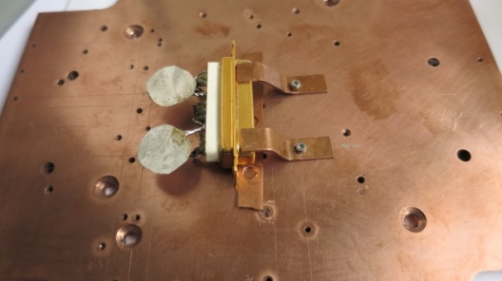
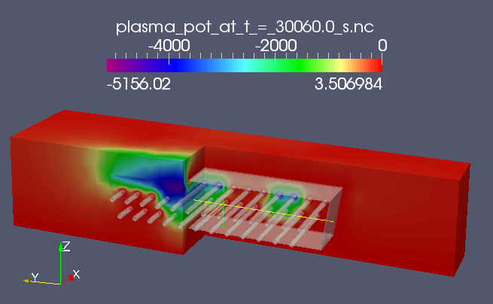
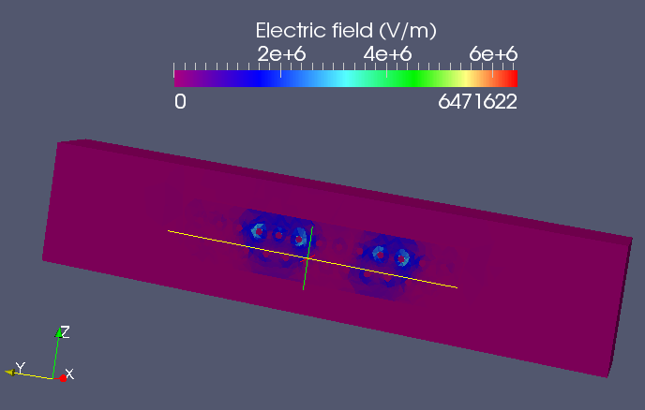
Simulation tools
3-d internal charging - 3DMICS/CIRSOS
(ONERA, Artenum, Radmod, Kallisto, Airbus D&S, Etamax, DHC, PSI, INTA)

Slide 5
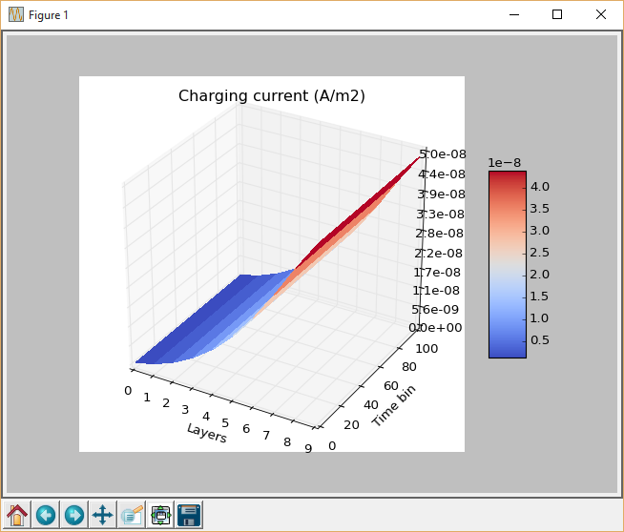
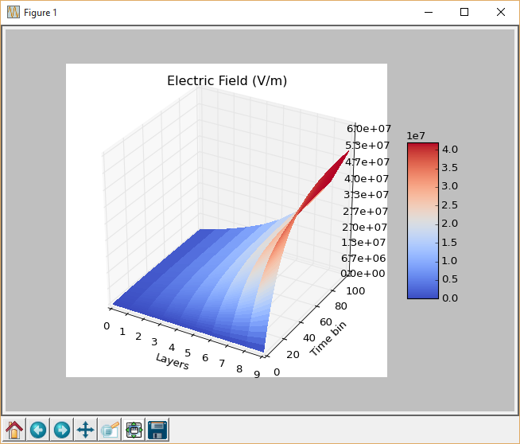
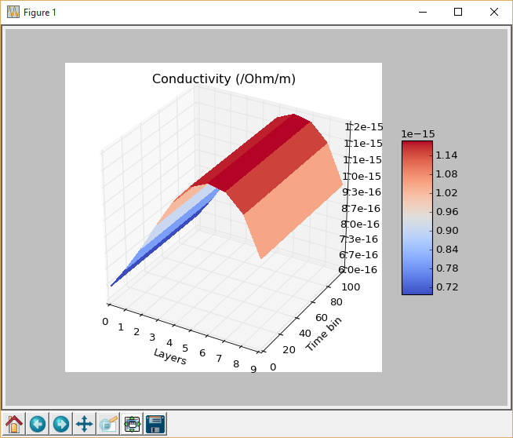
Simulation tools
MCICT
(Radmod, Kallisto)
Notes:
MCICT ‐ Introduction
 New 1D Internal Charging Tool, to be used for the JUICE mission and
other environments with high radiation‐belt electron fluxes
 Better particle transport treatment than in DICTAT –MC approach –
hence improved current deposition and dose
 Multiple layers of shielding and dielectrics –more layers and more
materials than DICTAT
 DICTAT charging physics model as baseline, but extendable to improved
algorithms or models.
 Time‐dependent environments
 Performance acceptable compared to DICTAT
 To be accessible via SPENVIS (https://www.spenvis.oma.be/)

Slide 6
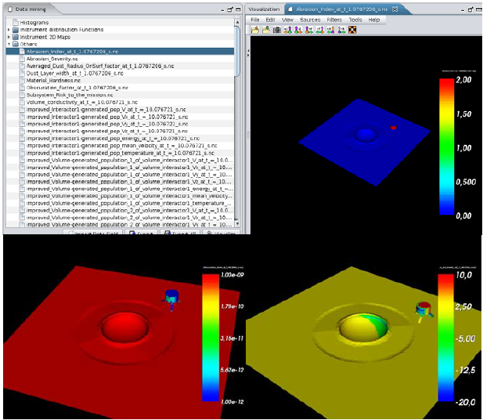
Simulation tools
SPIS-DUST
ONERA, U. Lancaster, Artenum

Slide 7
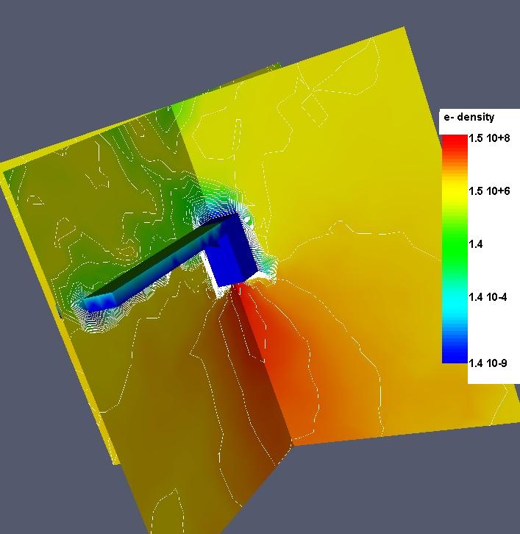
Simulation tools
Just starting:
SPIS-EP
(ONERA, Artenum)
and
Plume model and
Experimental
Validation
(Airbus et al.)
SPIS, Smart-1

Slide 8
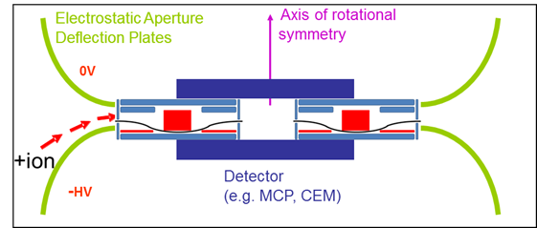
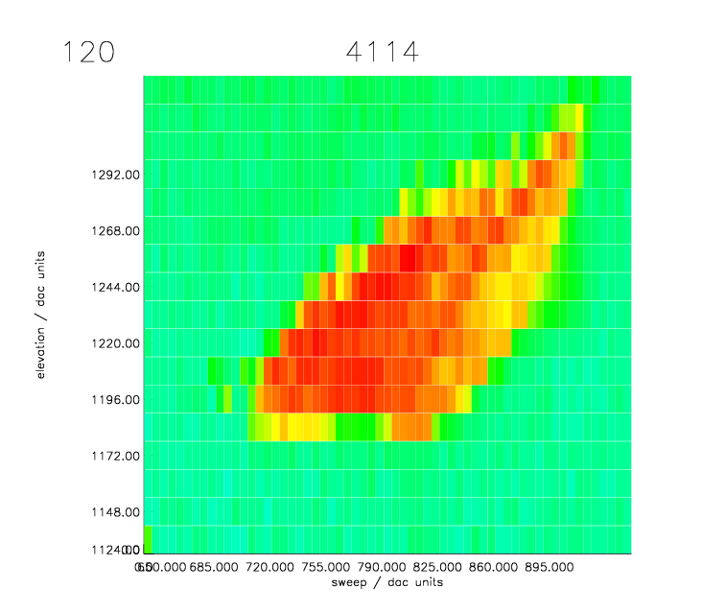
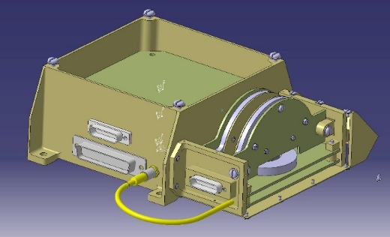
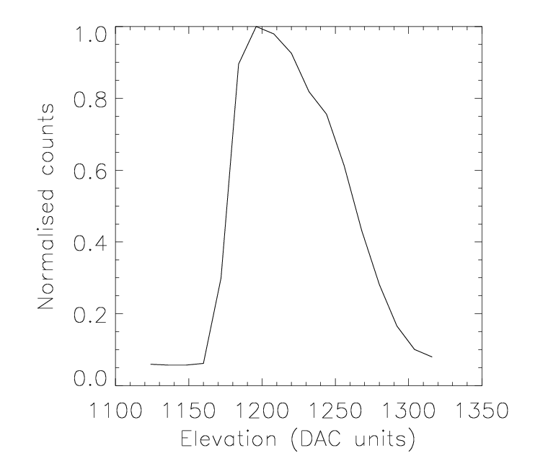
Instrument developments
HOPE-M (MSSL/UCL)

Slide 9
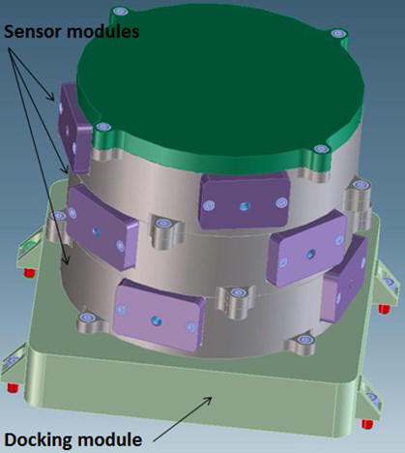
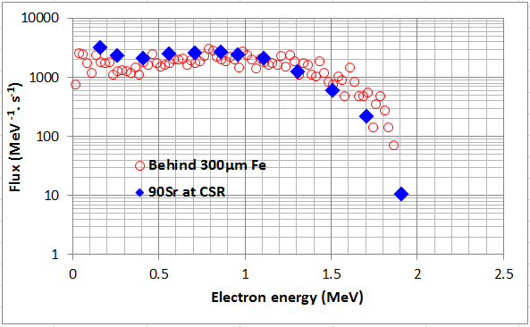
Instrument developments
3DEES
(QinetiQ-Space, UCL/CSR, BIRA)

Slide 10
Instrument developments
Multi-needle Langmuir probe
(Eidel, Norway)

Slide 11
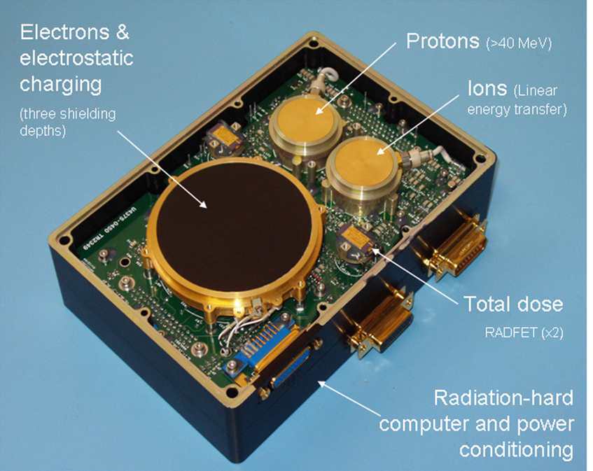
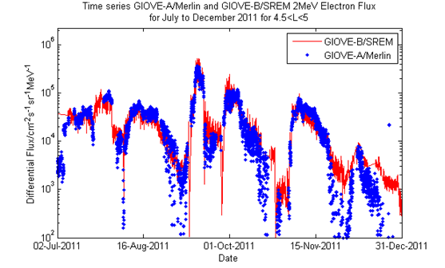
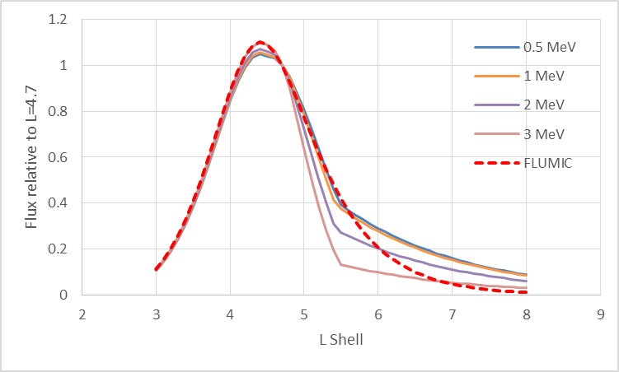
Charging environment definition
MOBE-DIC
(U.Surrey, UK)

Slide 12
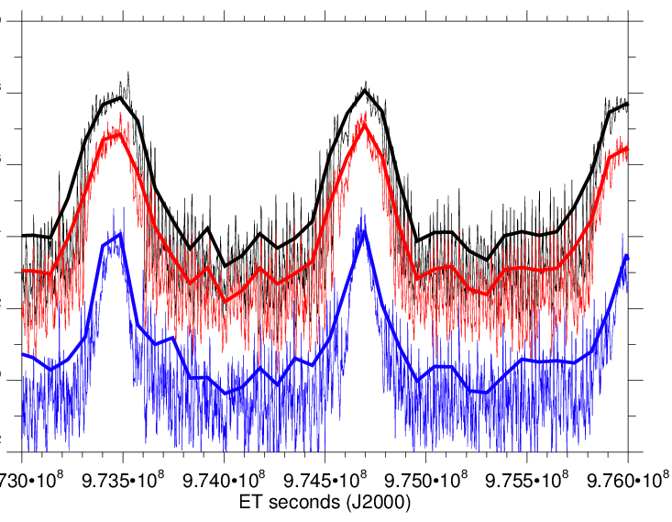
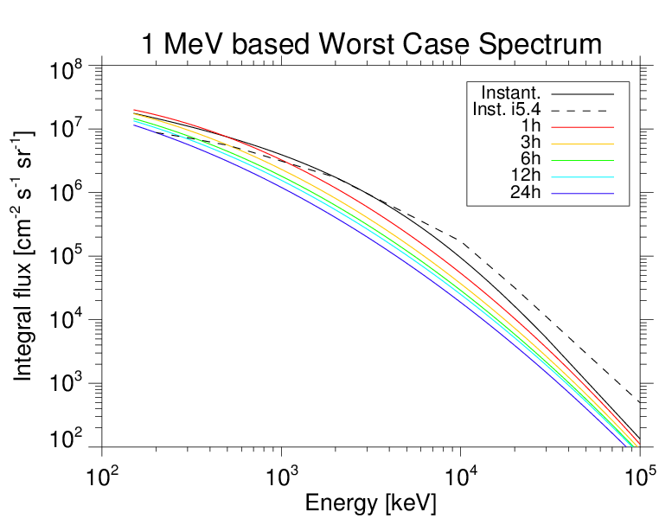
Charging environment definition
JCAT/HPEM
(MPS, Germany)

Slide 13
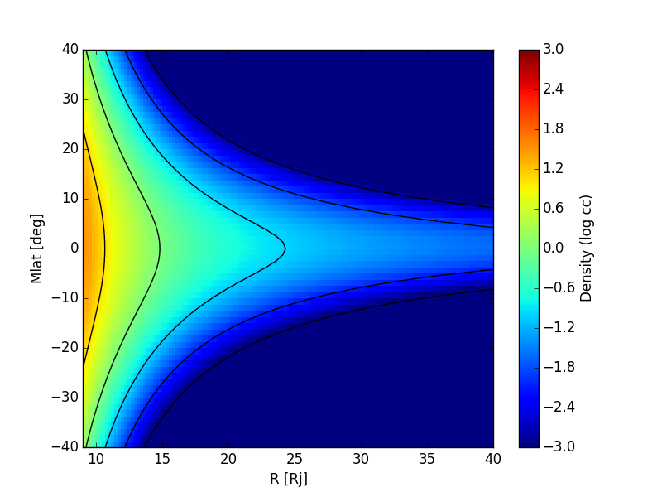
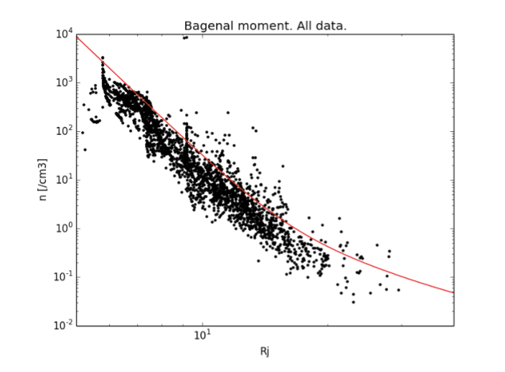
Charging environment definition
JCAT/CPEM
(IRF, MPS)

Slide 14
Contribution to standards
ECSS-E-HB-20-06A Assessment of spacecraft worst case charging handbook - in preparation
how to assess the worst case absolute and differential charging of a space system - definition of worst case environments - rules for numerical modelling of spacecraft charging
ECSS-E-ST-10-04C Space Environment – periodic update ongoing
ISO activities
ISO/AWI 19923 “Spacecraft potential estimation in worst case environments” (K.Toyoda, KIT, Japan)
ISO/AWI 20584 “Space environment (natural and artificial) -- Spacecraft charging -- Earth orbit” (D.Ferguson, USAF, USA)

Slide 15
Future plans
Model of ion emitter environment (approved)
Miniaturised ion emitter (priority 2)
Solar wind particle spectrometer for SSA (to be proposed in SSA ph3)
Hot plasma monitor for SSA (in SSA plan)
Discharge monitor (TBD)
Mission to L1-L5 for SSA (to be discussed as proposal for SSA Ph3)
m-NLP PFM (in SSA ph3).

Slide 16
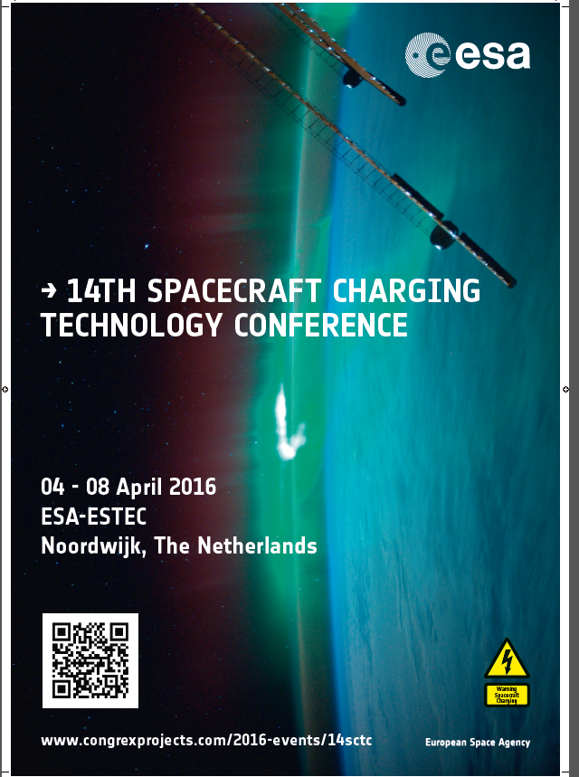
Summary
Technology developments and analyses in the field of spacecraft charging and spacecraft plasma interactions continue to be made in ESA sponsored activities and elsewhere in Europe.
Drivers:
  Electric orbit raising
  Missions to Jupiter, near-Sun
  Magnetospheric missions
  Lunar and asteroid missions
  L1/2, SSO and Galileo orbits
  SSA/Space Weather

Slide 17
END
The END

Slide 18
Who is active in SPINE?
Active entities in SPINE
SPINE 2015
  ONERA, Artenum, Airbus D&S, IRF, EMI Fraunhofer, MSSL/UCL, CNES, ESA, CNRS, U.Surrey, Radmod, OBSPM, U.Lancaster, MPS, OHB, TAS, PSI, Kopoos, SES, LPP/CNRS, IRAP
SPINE 2016
  Artenum, CNES, IRAP, ESA, ONERA, Selex-ES, FOTEC, UC3M, Finmeccanica, Gradel, LESIA

