Slide 1
Parametric study of lunar dust simulant charging and transport under VUV irradiation
Amandine CHAMPLAIN
PhD, 3rd year
ONERA, DESP, CSE
PhD director : Jean-François ROUSSEL
ONERA supervisor : Jean-Charles MATÉO-VÉLEZ

Slide 2
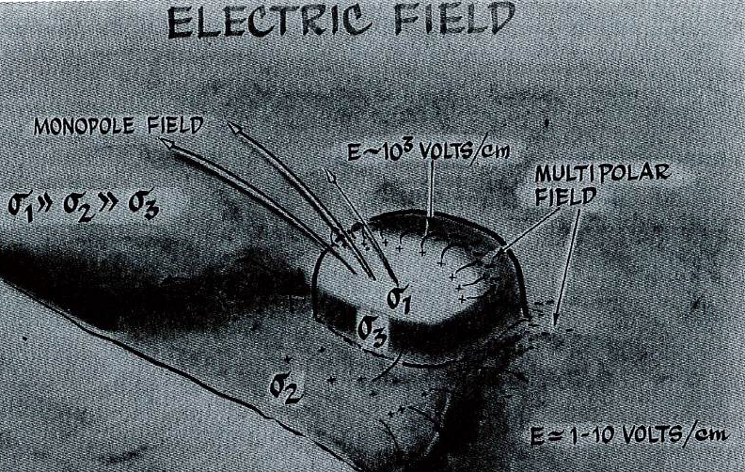
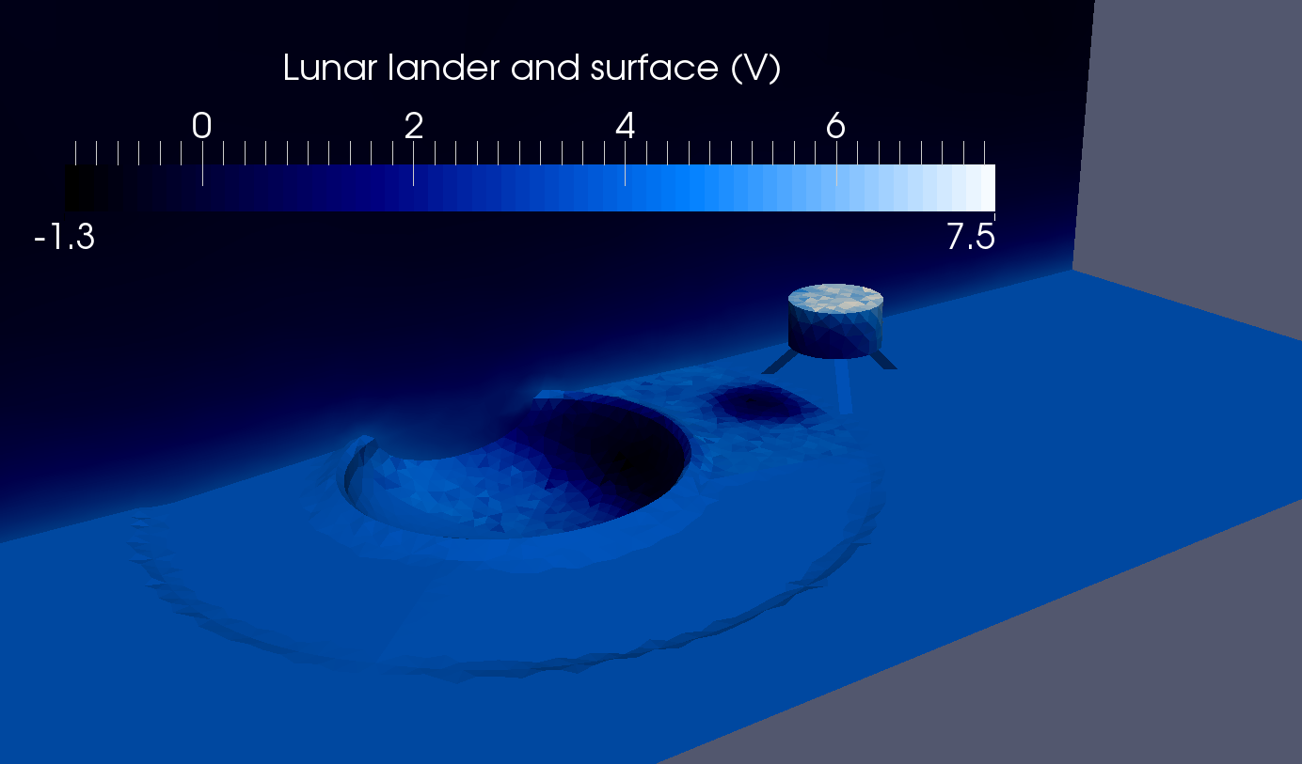
Study origins
The lunar surface is covered by dust grains whose properties are:
    Mainly composed of SiO₂
    Size about 20 µm
    Very abrasive and adhesive
These grains are observed in suspension above the lunar surface for the first time by Apollo 17 mission. This phenomenon is called Horizon Glow. It is caused by:
  An electric field amplification at sunlit/shadowed areas boundaries (relief, craters)
  Micrometeorite impacts which are supporting the lunar dust transport
[Criswell and al. 1973]
The study of this phenomenon is realized in particular by the use and the development of SPIS-Dust software for the realization of numerical models used in ESA contracts.

Slide 3
Scientific and economical context
Several missions (in progress or future) aim to send equipment on the Moon or on asteroids:
  ESA / Rocosmos collaboration in progress
  Yutu rover send by China the 14th of December 2013
  NASA Orion project
  ESA NEMS and Moon Era 2020-2030 projects
  Rosetta mission of comet 67P/Churyumov-Gerasimenko
  These projects justify the study of lunar dust since it can interfere with their success in several ways:
    Instruments and materials degradation
    Risks for the astronauts
    Measures misreading, …
Dust motion caused by human and/or robotic activities
Objectives:
  Understand the dust dynamic caused by environmental conditions
  Model this physic in order to provide data to prevision codes
  Imagine an efficient mitigation technique to protect equipment

Slide 4
Scientific approach
Observations
  Fines particles presence in suspension above the lunar surface
  Pollution and degradation of equipment
Transport characterization
  Analyze of lunar environmental conditions
  Bring out the parameters influencing dust transport
Experimental study
  Development of an experimental setup
  Parametric study of dust transport
Numerical study
  Simulation of dust transport with SPIS-Dust
  Comparison with experimental results
Utilization
  Use experimental results to complete numerical model

Slide 5
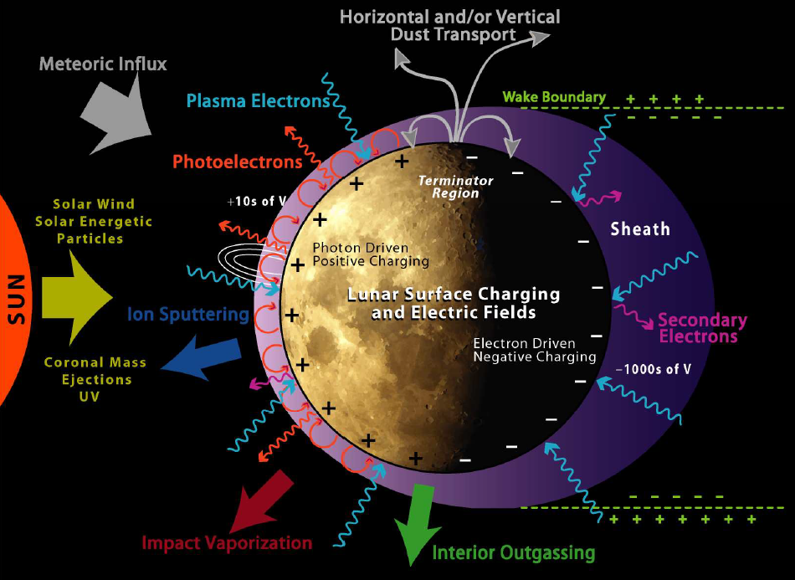
Lunar environment
I_{i}
I_{e}
I_{sec}
I_{hυ}
I_{ph}
Lunar surface
[T. J. Stubbs and al. 2014]
Notes:
Parler de la surface qui a des courants positifs et négatifs (macro)
Puis même chose à l’échelle du grain

Slide 6
At grain scale
Grain properties
  Size r_{d}
  Charge Q_{grain}
  Conductivity
  SEE
External parameters
  Effect of topology on E
  Thickness of the dust layer
Dust transport
In presence forces
  Electrostatic force F_{e}
  Gravitational force F_{g}
  Cohesion force F_{c}
  Seismic force F_{s}

Slide 7
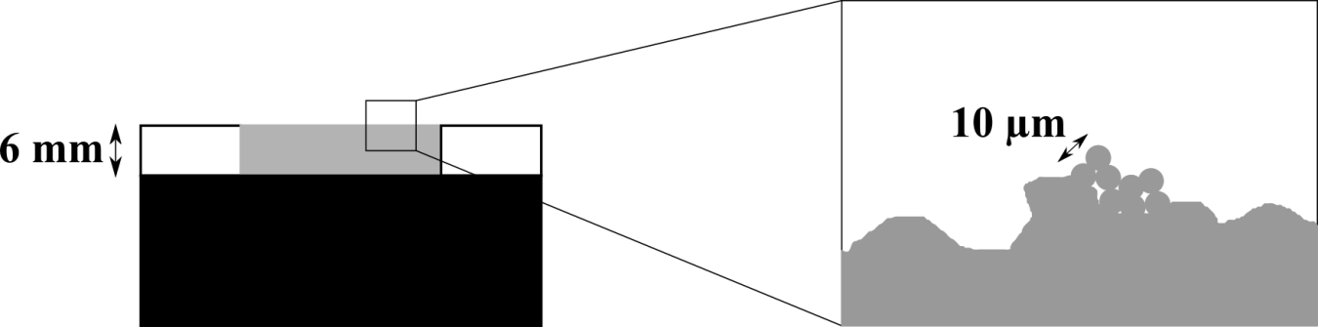
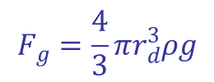




SPIS-Dust physical model
$$F_{g}=\frac{4}{3}πr_{d}^{3}ρg$$
Transport
$$F_{c}=KS²r_{d}$$
$$F_{e}>F_{c}+F_{g}+F_{s}$$
$$F_{e}=Q_{grain}E$$
$$F_{s}=0$$
Use of an amplification factor β on grain charge and electric field
The amplification factor β consider enhancement effects at the surface of the dust layer, at microscopic scale. These effects are also highlighted by the presence in the simulation input parameters of a grain to grain conductivity. This parameters is different from the conductivity through the whole thickness of the dust layer.
Notes:
Les modèles théoriques prédisent qu’il faut aller voir à une échelle micro pour favoriser le départ

Slide 8
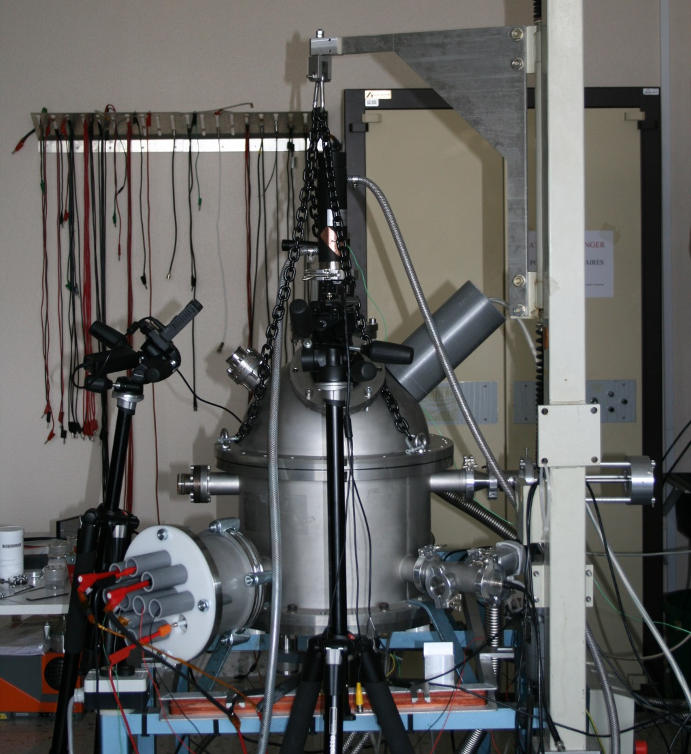
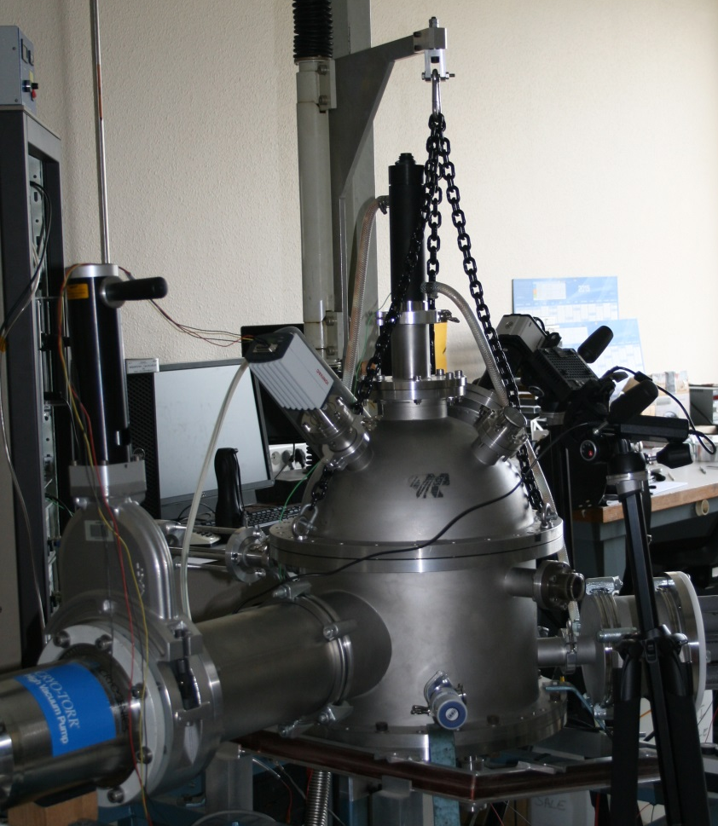
DROP (Dust Regolith Or Particles)
Installation of primary and secondary pumping systems
Cleaning of the chamber by heating
Isolation of high tension breakthrough
Calibration of used sources and instruments
UV Lamp
UV Lamp
Kelvin probe power supply
Lamp
Camera
Translation axis
HT Breaktrough

Slide 9
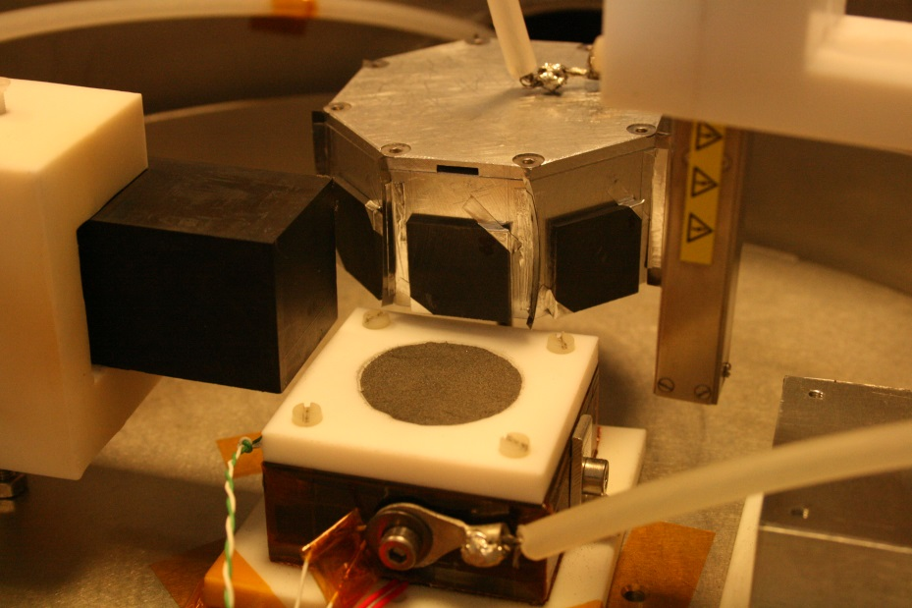
Experimental protocol
Move dusts
Large electric field
Representative of a shadow/light boundary
Dust layer thickness: 6 mm
Dust mark diameter: 30 mm
Distance between blocks and dust mark center: 25 mm
Altitude of blocks above the surface of dust: 5 mm
VUV Irradiation duration: 15 minutes
Dust simulants: DNA-1 (EU) et JSC-1A (USA)
Grain size: all sizes
Applied potentials: 1000 ≤ V₊ = -V₋ ≤ 7000 V
Weighing of samples before and after
VUV
-
Dusts
+
E
e-
E
+

Slide 10
Dust charge
Comparison between experimental and numerical results for V₊ = -V₋ = 3000 V, dust support at the ground
Notes:
Hoping dans l’autre sens : on part du bloc positif et le hoping permet de garder la charge + même vers le bloc –

Slide 11
Conductivity
Measures of potential decay after 1 minute of VUV irradiation with dust support polarized at -3000 V
Study of the temperature influence

Slide 12
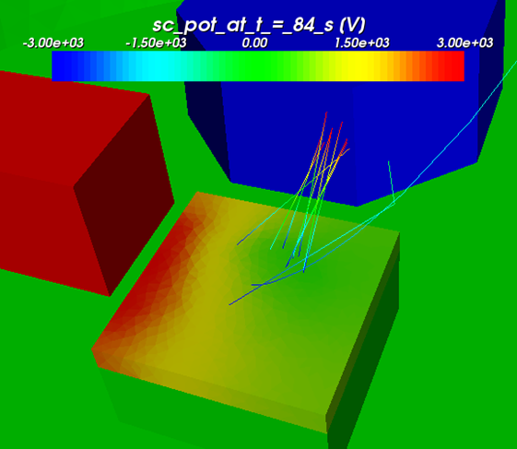
Dust transport
Simulations give a value of the vertical component of the electric field equal to 2,7 × 10⁴ V/m, for V₊ = -V₋ = 3000 V.
Five “target” samples tested:
Aluminum
Anodized aluminum
Polished aluminum
Graphite
MLI
Samples | Threshold potential (V₋ = -V₊)
Aluminum | -3000 V
Anodized aluminum | -3500 V
Graphite | -2500 V
MLI | -4000 V
Polished aluminum | -3000 V
The mean potential threshold allowing an observation of the contamination is about 3200 V. The differences of the values between the samples can be from:
The reproducibility of the dust layer surface (around 10 – 20 % )
The samples thickness differences
Their nature (dielectric or conductor)

Slide 13
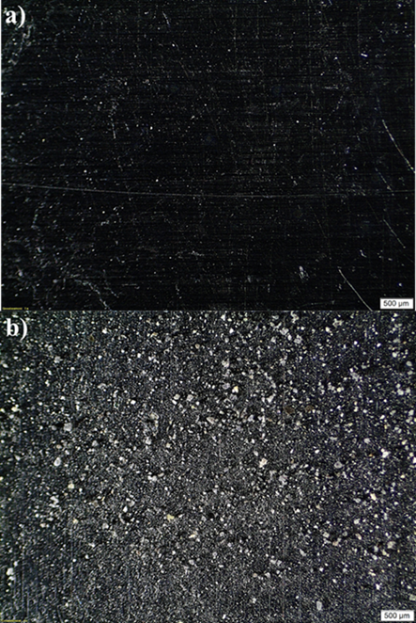
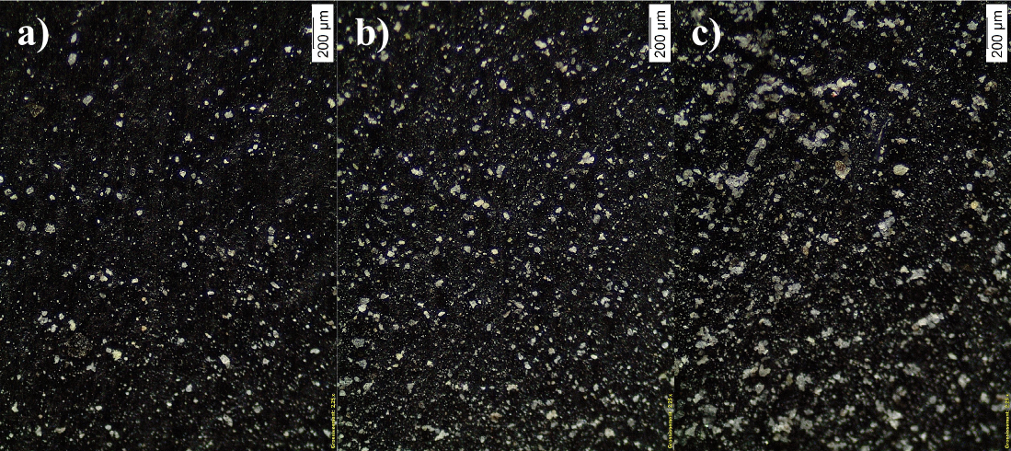

Sample contamination
1^{rst} observation: increasing of the contamination with the value of the applied potential
2nd observation: the use of a piezoelectric agitating system to vibrate dust support increase the contamination for the same applied potential
3rd observation: use of the obscuration factor
$$Obscuration factor=\frac{Contaminated surface}{Sample total surface}$$
3500 V without piezoelectric system (potential threshold at 3000 V)
Weighing: 40 µg
Sample | Threshold (V₋ = -V₊) | Obscuration factor
Aluminum | -3500 V | 5 %
Anodized aluminum | -4000 V | 4 %
Graphite | -3000 V | 11 %
MLI | -4500 V | 18 %
Polished aluminum | -3500 V | 2 %
Aluminum without piezoelectric system | -3500 V | 37 %
SPIS with default parameters | -3000 V | 15 %
SPIS with size distribution divided by 2 | -3000 V | 20 %
SPIS with size distribution multiplied by 10 | -3000 V | 5.5 %
SPIS with reduced conductivity | -3000 V | 1.5 x 10⁻⁴ %
2000 V (before threshold)
Weighing: 70 µg
2500 V (threshold)
Weighing: 140 µg
3500 V with piezoelectric system
Weighing: 390 µg
3000 V (after threshold)
Weighing: 200 µg
Notes:
Facteur 1 à 3 entre simu et manip
Capables de faire des manips dont la physique est comprise dans les grandes lignes et qui n’ont jamais été réalisées (1ère fois)

Slide 14
Assessment
Realizations:
Definition of parameters influencing dust transport
Adaptation of a vacuum chamber for experimentations with dusts
Creation of an experimental protocol allowing the observation of dust electrostatic transport
Realization of simulations taking back the experimental environment with SPIS-Dust
Results:
Confirmation of the positive charge of dusts by VUV irradiation
Measures of potential profiles
Study of conductivity : difference between grain to grain conductivity at the surface et conductivity through the dust layer thickness
Study of electrostatic transport and of the samples contamination: tension thresholds, obscuration factor
Parametric study on grain size, temperature, presence of vibrations and surface conductivity
Comparison between experimental resutls and numerical simulations
Discussion:
Refining of the numerical model and especially of cohesion (KS²) and amplification (β) factors thanks to the experiments
Need to characterize this grain to grain conductivity at the surface
First steps toward efficient mitigation technics (vibrations)

