Slide 1
22d SPINE Meeting
MATREX - Material Recording Experience: CNES materials database for space applications
Hélène Combes
23/03/16
Sous-direction Assurance Qualité
Service Technologies Matériaux et Procédés
CNES Toulouse

Slide 2
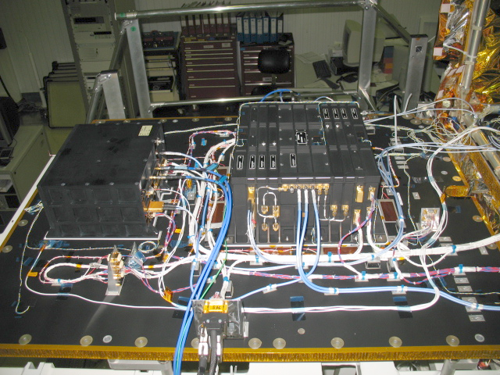
T2L2 integration on Jason-2
satellite
Design and use justification for new missions (materials’ properties, qualifications, anomalies)

Slide 3
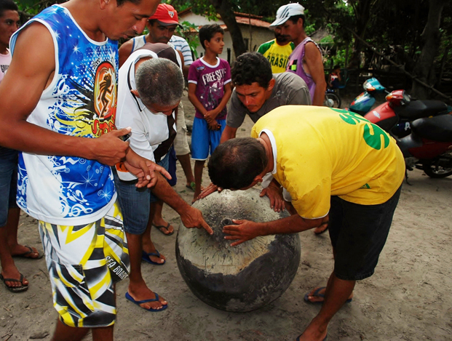
Titanium tank having survived an atmospheric re-entry
Materials re-entry
(materials’ properties)

Slide 4
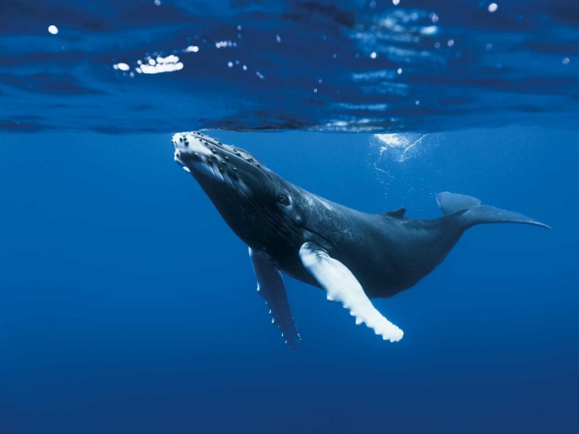
Environmental pollution induced by the end of life of the spacecraft elements in case of re-entry
(toxicity data)

Slide 5
Risks regarding the procurement (REACh, export control items…)

Slide 6
Why a DB?
capitalisation
efficiency
COST / TIME SAVING
collaboration

Slide 7
Share information in a community
Working groups (MPTB)
Use of M&P on space projects (DMMPPL, validations, anomalies…)
Risks linked to M&P procurement or use (REACh, ITAR…)
MATREX
Collect data on performances of materials (TD, MSDS, tests…)
Use anomalies return of experience
Verify that the choice of materials is corresponding to the needs in design phase
Check if the use of materials is conform to recommendations

Slide 8
Private data
Viewer
Public data
Admin
MATREX
External editor
Editor responsible
Editor

Slide 9
EXISTING DB
DB | Materials’ name | Materials’ properties | Toxicity data | Risks | Collabora-tive tool
MAPTIS
ESMAT
MAT DB SYS
MATREX

Slide 10
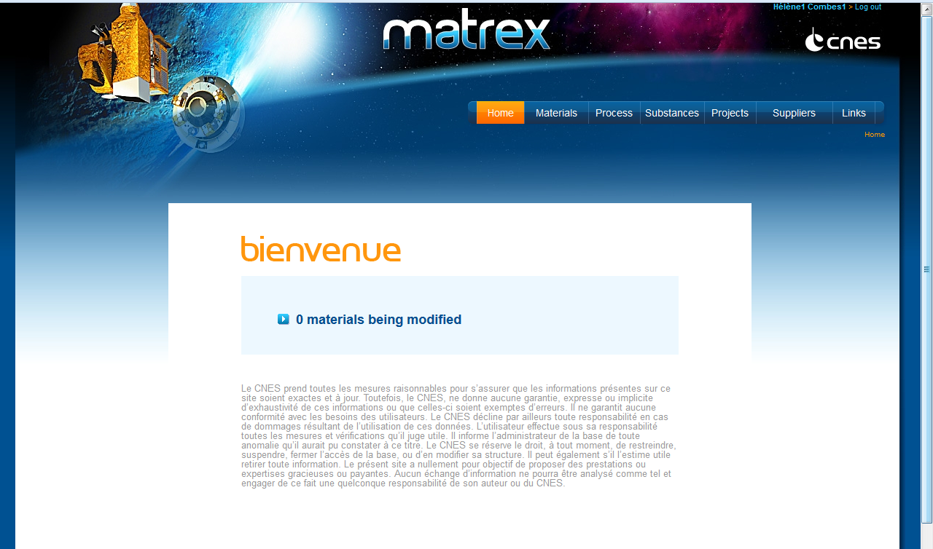

Slide 11
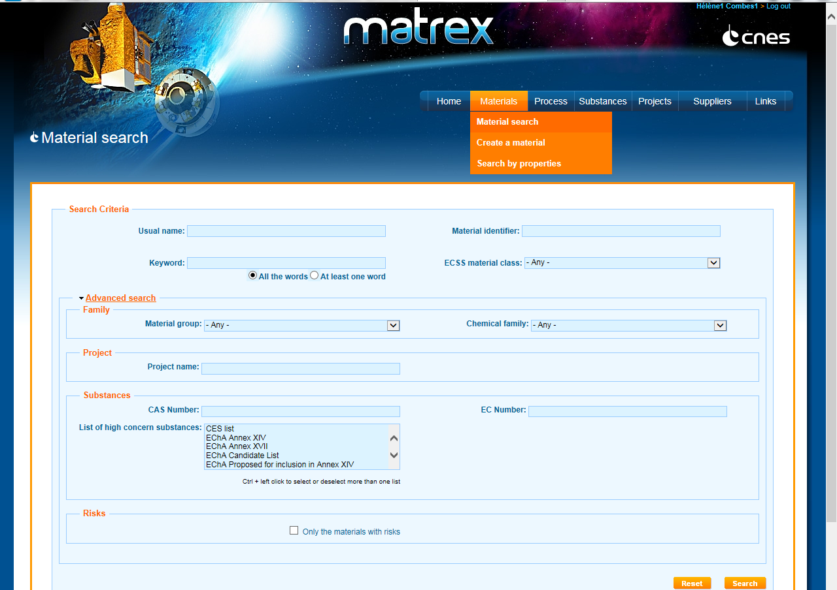

Slide 12
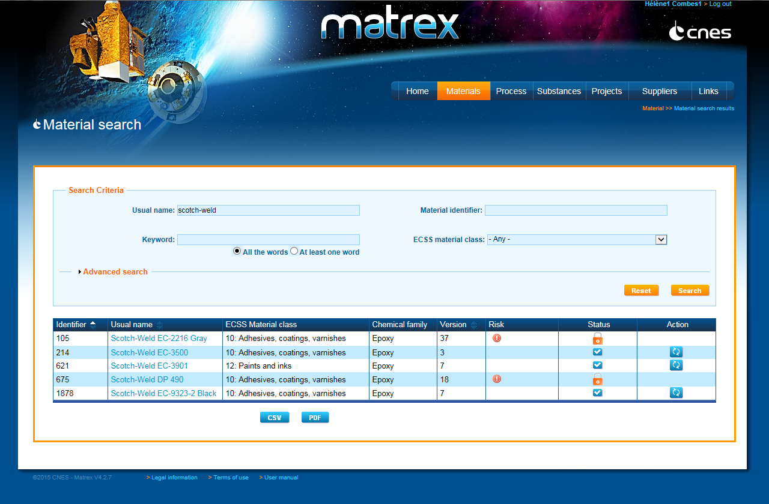

Slide 13
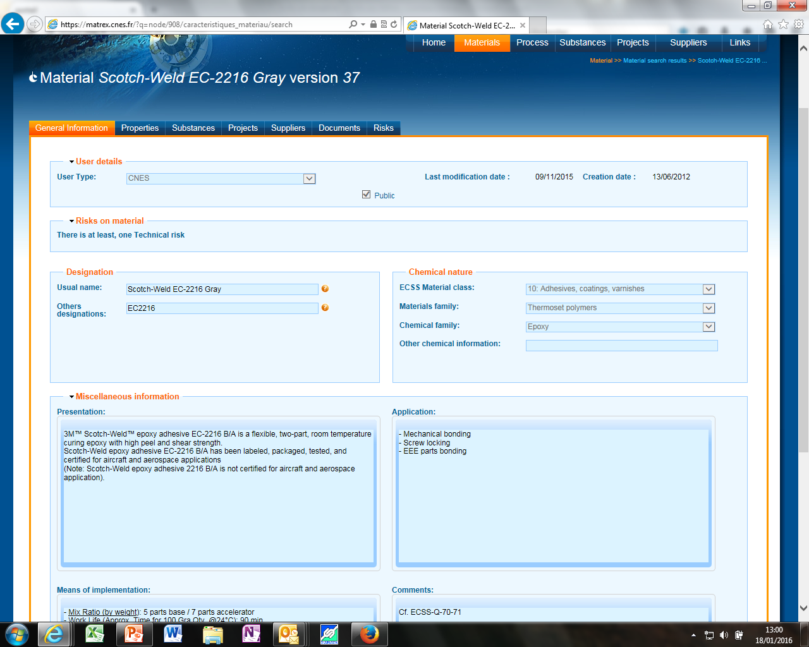

Slide 14
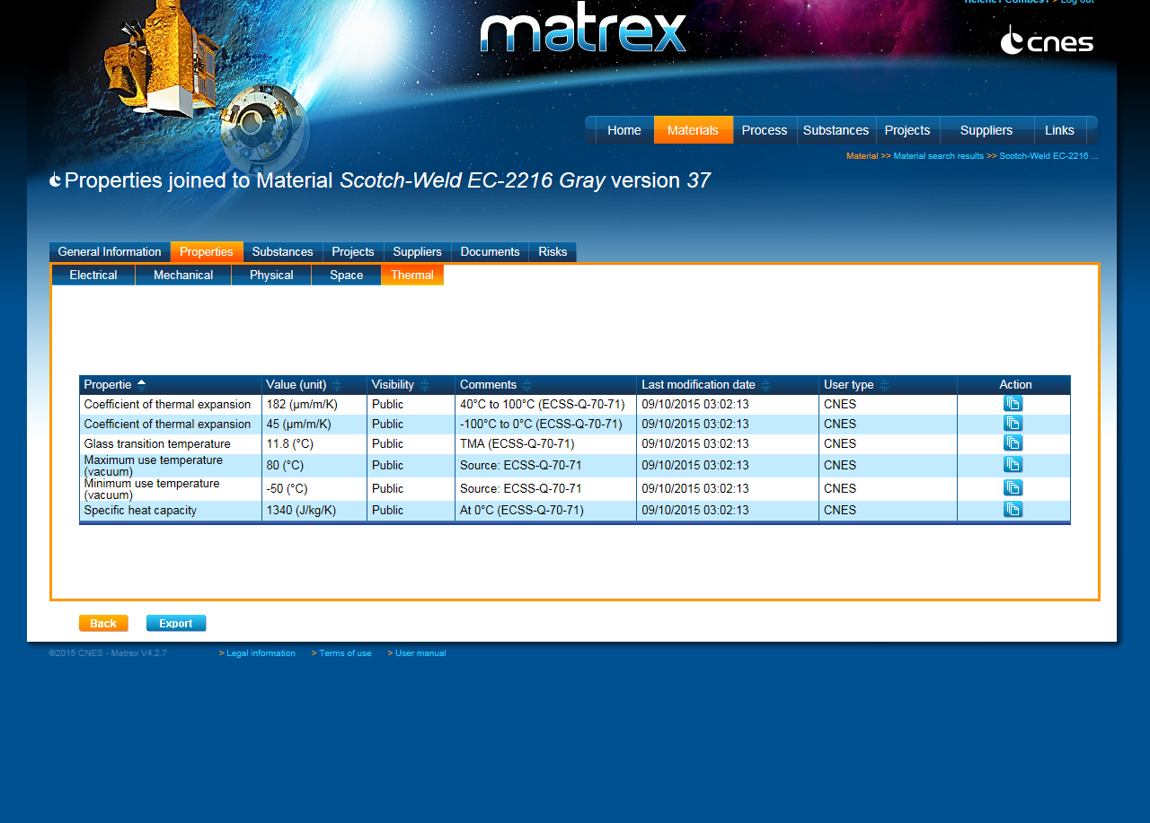

Slide 15
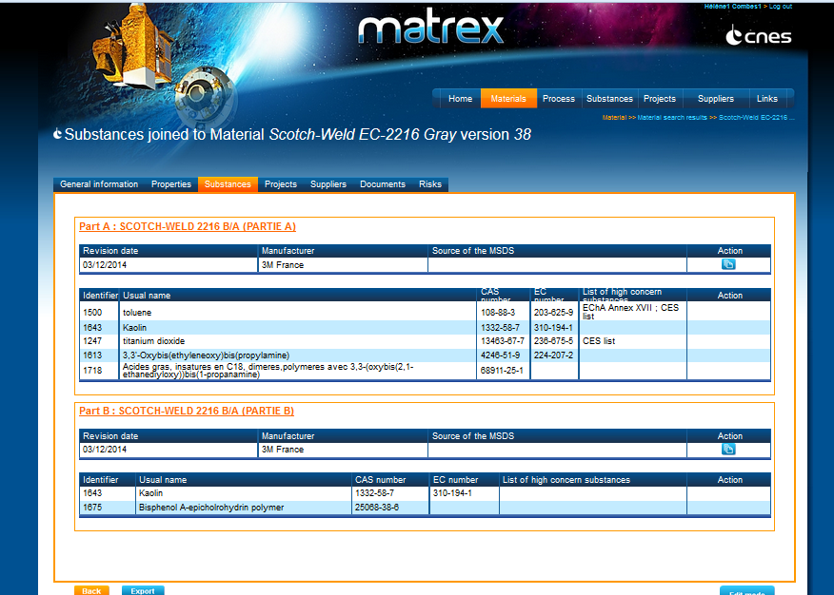

Slide 16
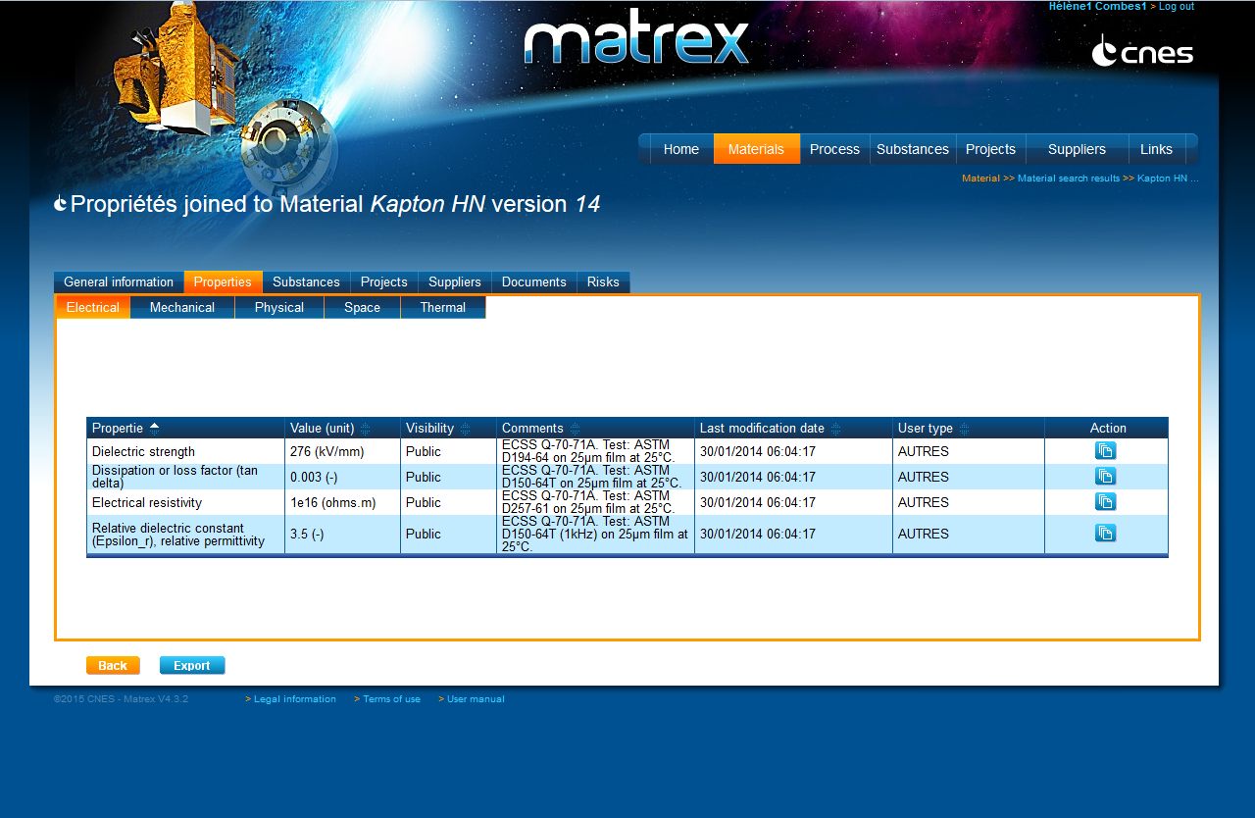

Slide 17
Who can ask for an access?
External users =
Materials experts* from companies or entities having a contractual link with CNES
+
Originating from EU (access conditioned to specific autorisation if not)
*on justification

Slide 18
MATREX ACCESSIBLE to cnes partners
4 levels:
external editor
external editor + Règlements & substances
Access to the module « REACh & substances » and to toxicity data to demonstrate conformity to French Space Act
external editor + SPIS : access to data shared between users of Spacecraft Plasma Interaction Software (SPIS)
external editor + Règlements & substances + SPIS

Slide 19
MATREX ACCESSIBLE to cnes partners
Account request online:
https://matrex.cnes.fr

Slide 20
MATREX ACCESSIBLE to cnes partners
Communicate on the opening of the DB
Add information: collaborative tool!
MATREX = evolutive tool => please transmit suggestions

Slide 21
outlook
=> European materials database (ESMDB)

